Slide 1

SAON Committee on Observations and Networks (SAON CON)
Hannele Savela, University of Oulu
SAON CON co-chair

Slide 2

Objective
“Promote and facilitate international collaboration towards the pan-Arctic observational system for long term acquisition and proliferation of fundamental knowledge on global environmental change, with a holistic Earth System Science perspective”

Slide 3
Goals
CON as the ”home of the networks”
provision of information on the baseline arctic observational assets
bringing together networks across domains (marine, atmospheric, terrestrial)
improvement of the Arctic observing networks (i.e. identify synergies, gaps, duplication)
sustainability of observational platforms among nations and organizations (including indigenous peoples)
improved planning/coordination (including funding) of current and future observational systems

Slide 4
Current activities
Development of CON ToR > draft waiting for finalization
Development of Work Plan for 2017-2019 > draft
Inventory of observational assetts, programs, projects, platforms and networks (part of EU-PolarNet Task 2.3 Optimisation of existing monitoring and modelling programmes)
GEO Cold Regions Initiative (jointly with SAON ADC)
  Support SAON as the Arctic extension to GEOSS
  GEO Community Portal Development
  Activities 2.1, 2.2., 3.2 related to infrastructures and ECRVs
Best practise for SAON Networks > inquiry of topics from networks
Participate/contribute to WMO Rolling Review of Requirements (RRR)

Slide 5
CON ToR: Structure
SAON CON is comprised of a Chairmanship, Secretariat and appointed representatives of SAON member countries, organizations, AC Permanent Participants and networks
  CON National/Organizational Representatives are appointed by the SAON Board
  Additional experts can be invited to join CON through an open nomination process, pending approval by the SAON Board
Inclusive approach > networks, programmes and projects interested in Arctic Observing are welcome to join SAON CON

Slide 6
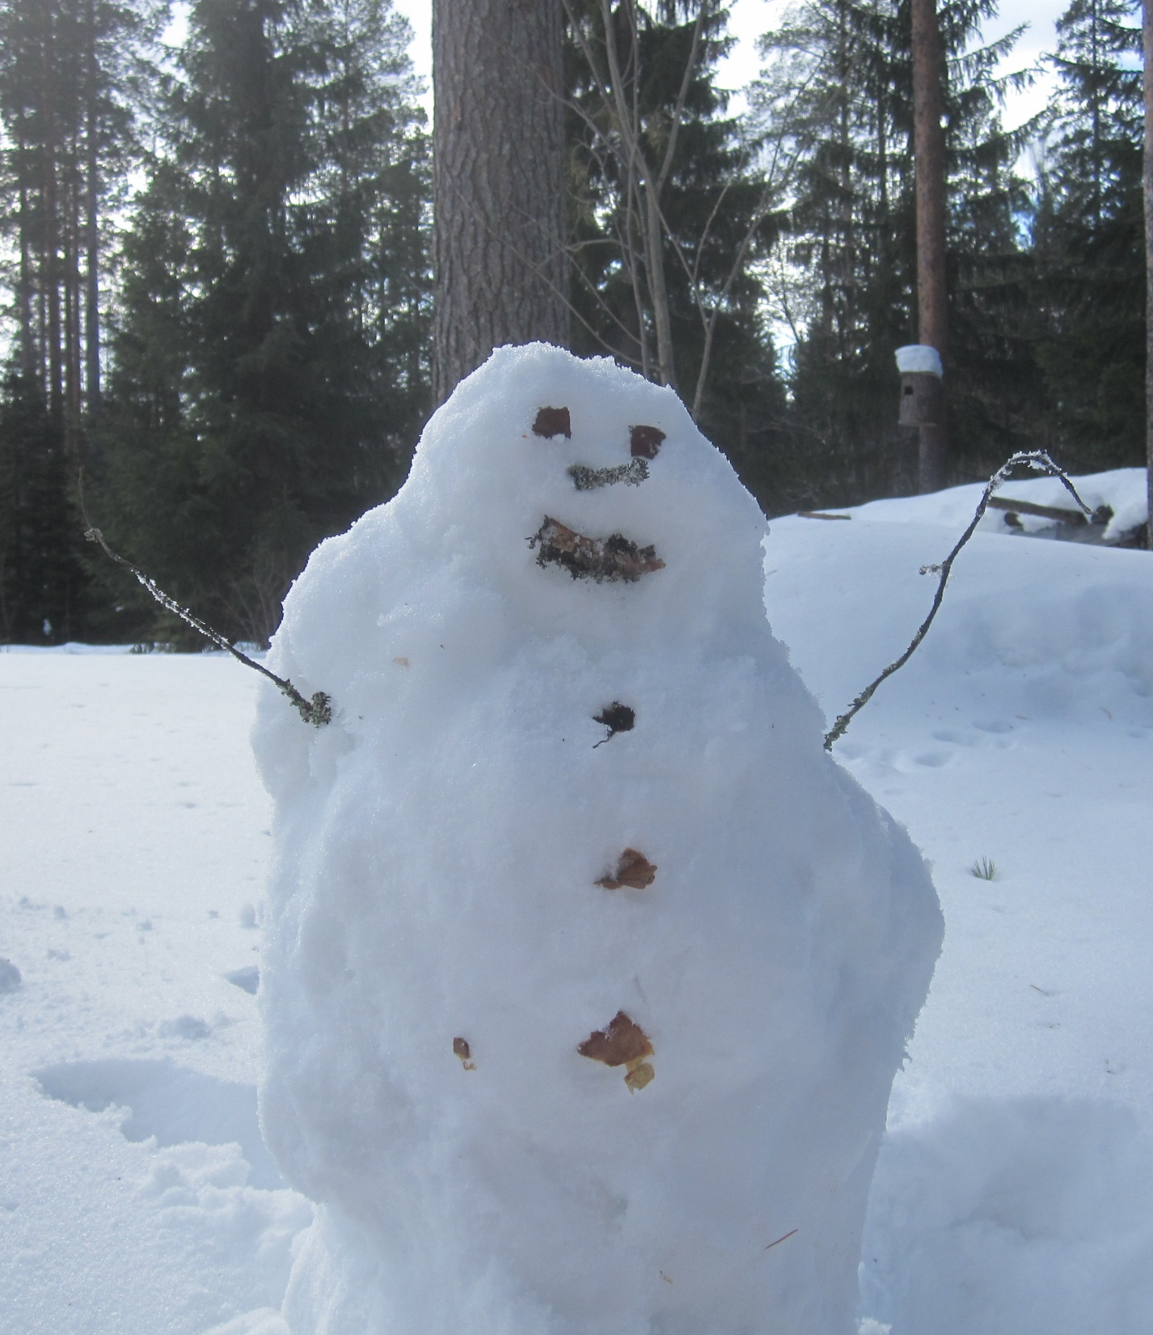
CON ToR: Meetings
Telecons every-other month, with the exception of the summer field season (June-August) > additional if required
Face-to-face meetings during the Arctic Observing Summit (AOS), a meeting hosted by SAON and IASC
> Additional face to face meetings with opportunistic gatherings/conferences

Slide 7
CON ToR: Tasks and activities
Advising the SAON Board on co-ordination/collaboration of Arctic observing activities
Coordination and support of the relationship between CON and national SAON committees
Supporting Arctic observational assets (project, programs, platforms, networks) via participatory engagement (e.g. inventories, meetings, events and workshops) and where possible with resources
Bring networks together across domains (marine, atmospheric, terrestrial)
Facilitating the sharing of best practises > topics asked from the networks, e.g. observing technologies!
Working with the partner SAON committee, Arctic Data Committee (ADC) on common strategies, meetings and products

Slide 8
CON ToR: Tasks and activities, cont
Participating and supporting inventory requests/needs for Arctic Council -relevant themes. Ensure engagement and linkages with inventory activities carried out by the Arctic Council Working Groups
Promotion and inclusion of community-based monitoring within the arctic observing activities within SAON
Work on best practices for the utilization of traditional and community-based knowledge in arctic observing
Developing partnerships with other initiatives (e.g. WMO´s Global Cryosphere Watch (GCI), GEO Cold Regions Initiative (GEOCRI) by membership, and joint meetings, activities and products
Lobbying for the sustainability of observing networks on various stakeholder levels

Slide 9
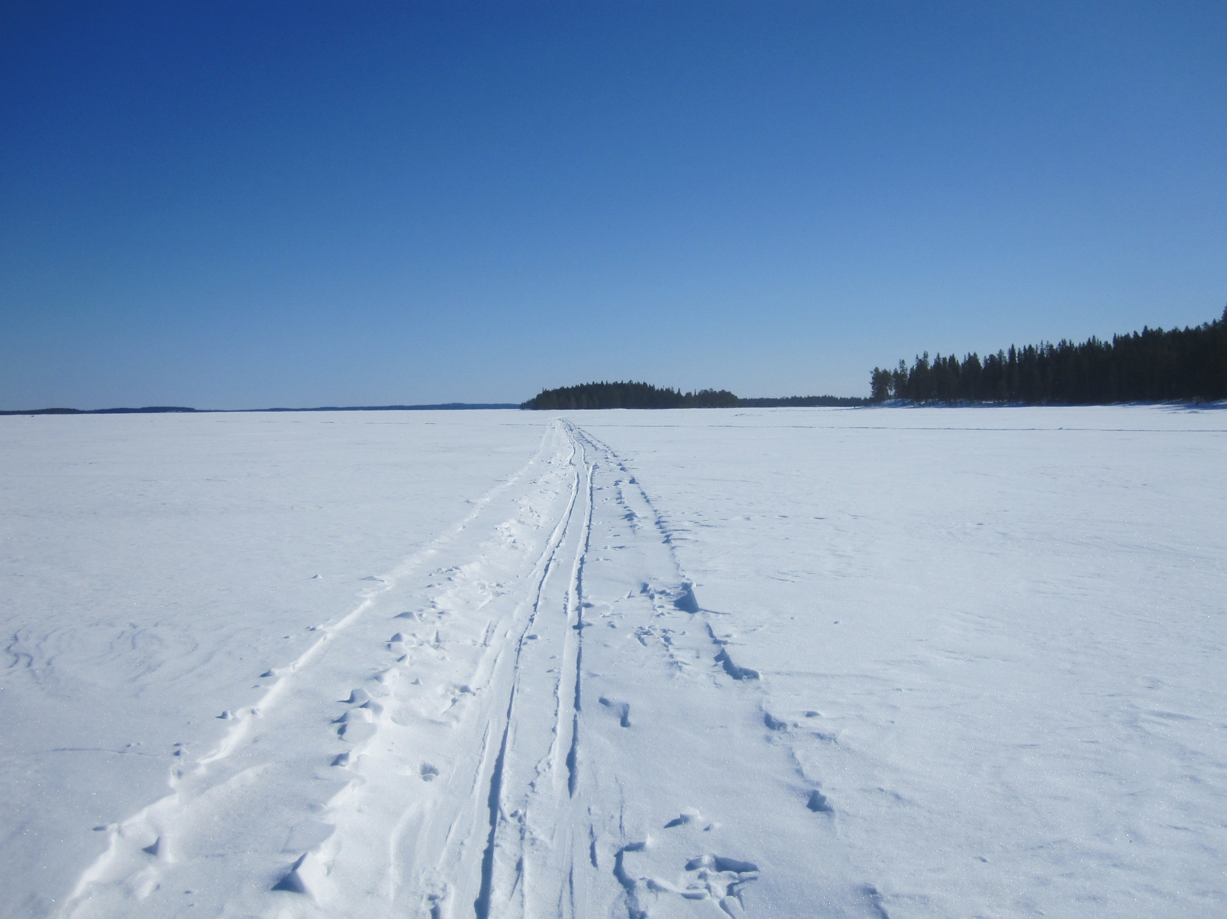
Work Plan
Follows the two-year AC chairmanship period > now being developed for the 2017-2019 Finnish AC chairmanship
  Developed by SAON CON, accepted by the SAON Board
Consists of Tasks and related Activities, Milestones and Deliverables
Next draft under development for CON meeting on 20th April

Slide 10
Work Plan 2017-2019
Bring the networks and observations together
  Meetings, workshops, joint sessions in congressess…
Contribute to Inventory of observational assetts, programs, projects, platforms and networks (part of EU-PolarNet Task 2.3 Optimisation of existing monitoring and modelling programmes)
Developing best practises for SAON Networks > inquiry of topics from networks, e.g. observing technologies
GEO Cold Regions Initiative (jointly with SAON ADC)
  Support SAON as the Arctic extension to GEOSS
  GEO Community Portal Development
  Activities 2.1, 2.2., 3.2 related to infrastructures and ECRVs
Contribute to WMO Rolling Review of Requirements (RRR)

Slide 11
Thank You!
Contact: lisa.loseto@dfo-mpo.gc.ca , hannele.savela@oulu.fi, jan.rene.larsen@amap.no

