Slide 1

SAON and the WMO
SAON Board teleconference 10 July 2019
(an update of presentation as SAON Board meeting, Arkhangelsk, Russia, 26 May 2019)
Etienne Charpentier
Chief, WMO Observing Systems Division

Slide 2




WMO STRATEGIC PLAN 2020-30
VISION 2030
A world where all nations, especially the most vulnerable, are more resilient to the
socioeconomic impact of extreme weather, climate, water and other environmental events, and
empowered to boost their sustainable development through the best possible weather, climate and water services
OVERARCHING PRIORITIES
Preparedness for, and reducing losses from hydrometeorological extremes
Climate-smart decision-making to
build resilience and adaptation to climate risk
Socioeconomic value of weather, climate, hydrological and related environmental services
CORE VALUES
Accountability for Results
and Transparency
Collaboration and Partnership
Inclusiveness and Diversity
1
2
3
4
5
LONG-TERM GOALS
Services
Better serve
societal needs
Systems
Enhance Earth system observations and predictions
Science
Advance targeted research
Support to Members
Close the
capacity gap
Smart
Organization
Strategic realignment of structure and programmes
STRATEGIC OBJECTIVES
FOCUSED ON
2020-23
Strengthen national multi-hazard early warning/alert systems
Broaden provision of policy- and decision-supporting climate, water and weather services
Optimize observation data acquisition
Improve access to, exchange and management of Earth system observation data and products
Enable access and use of numerical analysis and prediction products
Advance scientific knowledge of the Earth system
Enhance science-for-service value chain to improve predictive capabilities
Advance policy-relevant science
Enable developing countries to provide and utilize essential weather, climate, hydrological and related environmental services
Develop and sustain core competencies and expertise
Scale up partnerships
Optimize WMO constituent body structure
Streamline WMO programmes
Advance equal, effective and inclusive participation

Slide 3
WMO Priorities for Polar & High Mountain Regions 2020-2023
  Surface and Space Observations,
  Polar Predictions and Services, including Climate Services,
  Global Cryosphere Watch (GCW) Pre-operational Phase,
  High-Mountain Activities,
  Transition from Research to Operation and Services, and
  Resources and Partnership

Slide 4
WMO Strategic Plan areas most relevant to SAON
Core Values 2: Collaboration and partnership are highlighted as the foundation of the WMO mandate. This is as an important reason for WMO to work with SAON.
Goal 1: Better serve societal needs: delivering, authoritative, accessible, user-oriented and fit-for-purpose information and services
Objective 1.2: Broaden the provision of policy- and decision-supporting climate information and services
Objective 1.4: Enhance the value and innovate the provision of decision-supporting weather information and services
Objective 3.1: Advance scientific knowledge of the Earth system
Objective 3.2: Enhance the science-for-service value chain ensuring scientific and technological advances improve predictive capabilities
Objective 4.3: Scale-up effective partnerships for investment in sustainable and cost-efficient infrastructure and service delivery

Slide 5
WMO Strategic Plan SAON Strategy |  | WMO LTG1 (Services) | WMO LTG2 (Infrastructure) | WMO LTG3 (Research) | WMO LTG4 (Capacity dev.) |  | WMO LTG5 (Governance)
SG1 | Create a roadmap to a well-integrated Arctic Observing System
O1.1 | Conduct an inventory of national observational capacities |  | - OSCAR/Surface
O1.2 | Complete an assessment of adequacy of the Arctic observational capacity in support of Arctic Societal Benefit Areas (SBAs) | - P&HM Activity 2(a) - WMO Strategy for Service Delivery and it Implementation Plan, WMO No. 1129; Decision 42 (EC-68) - EC-PHORS Services White Paper | - OSCAR/Requirements - RRR Statements of Guidance, impact studies - EGOS-IP - WIGOS Vision 2040 | - P&HM activity 5(a) – Value chain - P&HM activity 5(b) – societal risks & opportunities - P&HM activity 5(c) – data assimilation & modelling, PPP, YOPP |  | - EC-PHORS guiding & blessing assessment
O1.3 | Provide recommendations for a roadmap for future Arctic observational capacities |  | - WIGOS Vision 2040 - WIGOS Operational Plan - Annex to draft Resolution 6.1(1)/4 (Cg-18) - P&HM activity 3(a) – GCW surface obs. Networks | - P&HM activity 5(c) – data assimilation & modelling, PPP, YOPP |  | - EC-PHORS guiding & advising on WMO contribution
O1.4 | Create opportunities to develop and implement observations in support of Arctic Societal Benefit Areas (SBAs) | - P&HM Activity 2(b) - ArcRCC Network & outlook forums | - P&HM activity 3(b) – Cryosphere monitoring - P&HM activity 3(e) – GCW partnerships for data access - P&HM Activity 1(c) – Synergies GCW – WHYCOS – WHOS - P&HM activity 1(d) – Community-based monitoring | - P&HM activity 3(e) - GCW partnerships for data access | - WMO Country Support Initiative - P&HM activity 3(f) | - WMO contribution to PAME - WMO Contribution to AMAP - Resolution 7.3(2) (Cg-18) - WMO Scientific and Technological Support to IPCC and Climate Policy
O1.5 | Develop a long-term repository for relevant project deliverables – establishment of ArcticGEOSS | PRCCs, PARCOF, GIPPS Weather Services HydroHub |  | P&HM Activity 5(d) – Demonstration projects for transition to operations |  | - EC-PHORS guiding development of projects

Slide 6
WMO Strategic Plan SAON Strategy |  | WMO LTG1 (Services) | WMO LTG2 (Infrastructure) | WMO LTG3 (Research) | WMO LTG4 (Capacity dev.) | WMO LTG5 (Governance)
SG2 | Promote free and ethically open access to all Arctic observational data
O2.1 | Create a road map outlining the steps towards achieving a system that will facilitate access to Arctic observational data |  | - WMO Information System (WIS) Strategy 2.0 - P&HM Activity 3(c) - GCW data portal, and 3(d) - Cryosphere products - P&HM Activity 1(e) – Satellite data utilization, PSTG - GCW Integrated Global Cryosphere Information System |  |  | - EC-PHORS defining strategy and guiding implementation
O2.2 | Advance a system to facilitate access to Arctic observational data | ArcRCC Network | - P&HM Activity 3(c) - GCW data portal, and 3(d) Cryosphere , products - P&HM Activity 1(e) – Satellite data utilization, PSTG - GCW Integrated Global Cryosphere Information System |  | - SO 4.3 - Scale-up effective partnerships for investment in sustainable and cost-efficient infrastructure and service delivery - Facilitate access to research observations in support of Earth System prediction | - EC-PHORS overall providing guidance
O2.3 | Establish a persistent consortium of organizations to oversee the development of a sustainable, world-wide system for access to all Arctic data | - EC-PHORS | - P&HM activity 3(c) - GCW data portal - P&HM activity 3(d) - Cryosphere products - EC-PHORS, GCW - P&HM Activity 1(e) – Satellite data utilization, PSTG | - EC-PHORS, PPP, YOPP | - EC-PHORS | - WMO part of SAON Consortium, working with partners - EC-PHORS defining strategy and guiding implementation - WMO participation in Arctic council

Slide 7
WMO Strategic Plan SAON Strategy |  | WMO LTG1 (Services) | WMO LTG2 (Infrastructure) | WMO LTG3 (Research) | WMO LTG4 (CD) |  |  | WMO LTG5 (Governance)
SG3 | Ensure sustainability of Arctic observing
O3.1 | Develop a strategy for long-term financial commitment in Arctic observations | WMO contributing to drafting strategy, with input related to observational requirements and gaps for ArcPRCC Network and Arctic Outlook Forums | WMO contributing to drafting strategy, with input related to (i) justification of the use of Arctic Observations in support of WMO application areas where services are delivered in the Arctic (WIGOS Vision 2040, EGOS-IP, GBON), (ii) WMO Members commitments to WIGOS in Arctic region, (iii) cryosphere monitoring observational requirements and gaps | - P&HM activity 5(c) – modelling techniques - P&HM activity 5(d) – Demonstration projects for transition to operations - P&HM activity 5(e) – Engagement with early career scientists |  | - WMO Country Support Initiative | - EC-PHORS defining strategy and guiding implementation (GBON, RBON, GCW) - P&HM activity 6(a) - Partnership - P&HM activity 6(b) – Resources & synergies
O3.2 | Apply the strategy developed in 3.1 to advocate to funding agencies and states to ensure sustainability of Arctic observing | TBD once strategy is drafted | TBD once strategy is drafted | TBD once strategy is drafted |  | - WMO Country Support Initiative | - TBD once strategy is drafted - EC-PHORS guiding implementation by WMO
O3.3 | Secure funding for international SAON secretariat and operational costs | n/a | n/a | n/a |  | n/a | - WMO Advocacy with AC - EC-PHORS for general guidance

Slide 8
Key WMO contributions and deliverables to SAON Strategy
SAON Strategic Goals | Key WMO deliverables or contributions (WMO Strategic Plan 2020-2023)
Goal 1: Create a roadmap to a well-integrated Arctic Observing System | LTG2, SO 2.1 – WIGOS WIGOS Vision 2040 OSCAR/Surface as inventory RRR: OSCAR/Requirements & Statements of Guidance, impact studies Implementation Plan responding to WIGOS Vision 2040, with key elements referring to SAON GCW Observing Network ArcRCC Network & Outlook Forums
Goal 2: Free & ethically open access to Arctic obs. data | LTG2, SO 2.3 – WIS WIS Strategy 2.0 Arc PRCC Data Portal GCW Data Portal GCW Integrated Global Cryosphere Information System WMO working with its partners, to be part of consortium (SAON Obj. 2.3)
Goal 3: Ensure sustainability of Arctic observing | LTG2, SO 2.1, SO 2.2 – WIGOS LTG4 – Capacity Development WMO Contributing to drafting strategy on the basis of WIGOS Vision 2040 and WMO contribution to Arctic SBAs. WMO Country Support Initiative with targeted use for Arctic Countries EC-PHORS defining WMO contribution to Strategy and guiding its implementation WMO Advocacy through EC-PHORS and Arctic Council

Slide 9
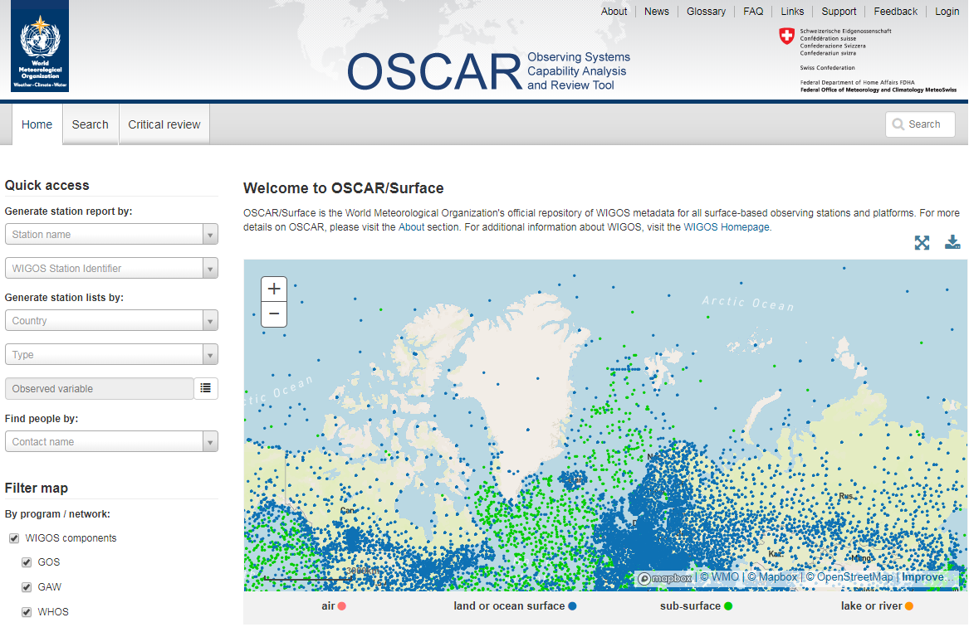

Slide 10
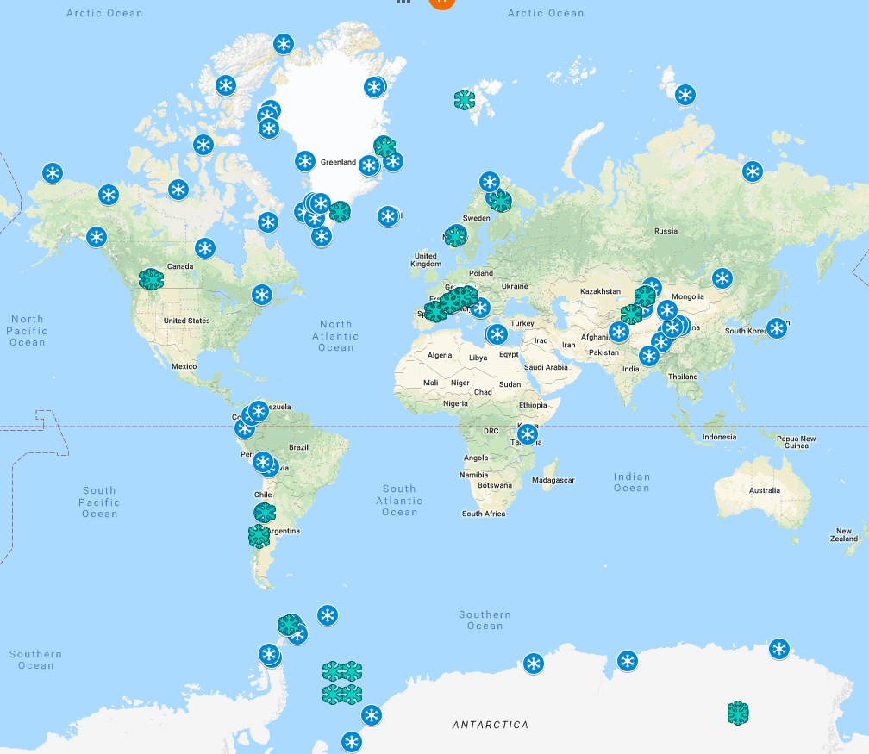
Resolution 29 (EC-70), 2018
GCW Surface Observing Network
http://globalcryospherewatch.org/cryonet/sites.php
Approved 153 stations, of which 105 are CryoNet:
Countries: 26
Regions: 5 plus Antarctica
Institutions: 41 (65% non-NMHSs)
20+ candidate stations
Significant interest (Azerbaijan, India, Kenya, Tajikistan, Chile, USA, etc)
Sea Ice Stations

Slide 11
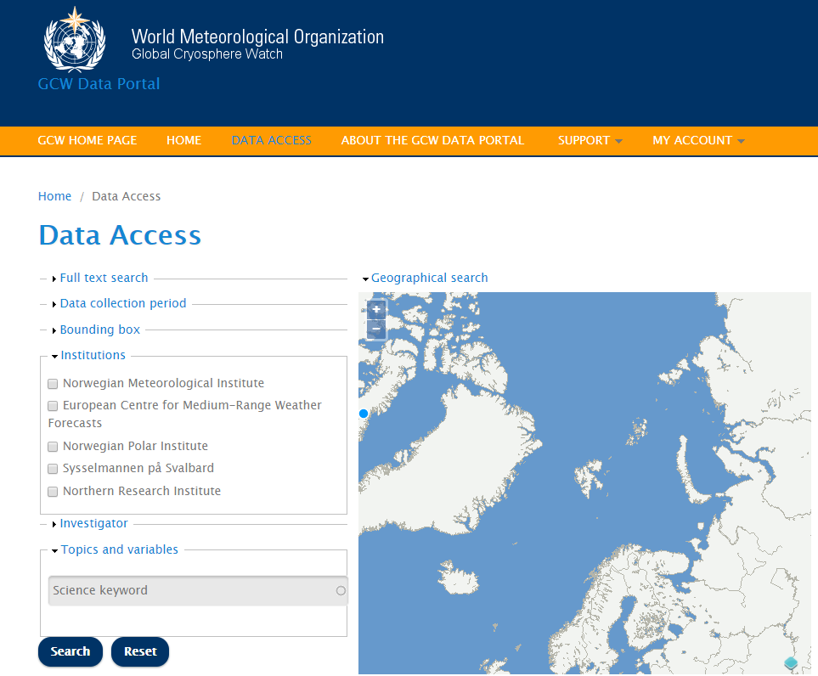
GCW Data Portal
Developed and hosted by Norway (MetNo)
https://gcw.met.no/data_access
Data interoperable with GCW stations (under development by SLF, Switzerland)
Interfaces with 80+ data centres.
Provides discovery metadata and data (as available) from
Provides visualization and transformation services
GCW data management follows a metadata driven approach

Slide 12
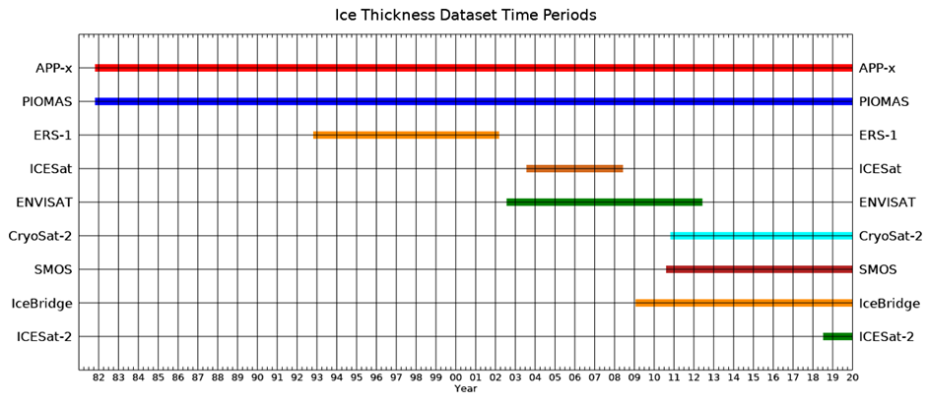
Satellite Product Intercomparisons
GCW leadership on:
  SnowPEx: ESA funded/conducted Satellite Snow Products intercomparison (snow cover and SWE)(2014 -16): final report pending.
  Planned: Sea Ice Product Intercomparison (proposal being developed by GCW for ESA) – sea ice thickness and snow on ice (2022+).

Slide 13
GCW Pre-operational phase 2020-2023 (deliverables )
Regulatory and Best Practices Material: WIGOS, WIS
Data interoperability: GCW Data Portal a Data Collection and Production Centre (DCPC) within WIS,
Surface network: representative stations from at least 80% of countries where cryosphere is present;
Integrated Global Cryosphere Information System
  assessments and products;
  Support PARCOF, HydroHub, WMO Statement on the State of the Global Climate;
Regional activities: In collaboration with the RA, addressing specific needs

Slide 14
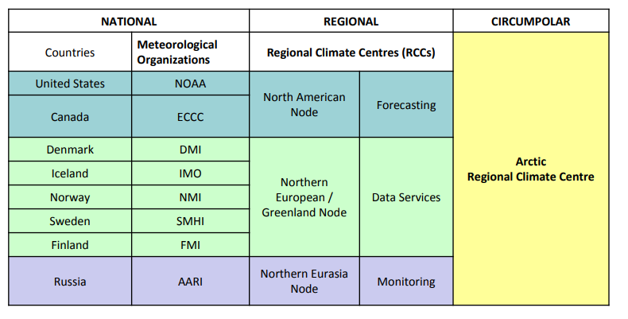
Arctic Regional climate Centre Network (ArcRCC-N)
(collaboration/networking across Arctic regional nodes and Meteorological Organizations)
Regional Climate Centres of excellence that link national meteorological services.
To share, coordinate and enhance climate products and services to:
  Fill geographical gaps in products and services between countries
  Fill gaps in products and services between countries
  Deliver and potentially harmonize products and services
  Enhance Research and development

Slide 15
ArcRCC-N Products
Seasonal Outlooks for the upcoming season: forecasts from models on temperature, precipitation and sea-ice forecasts
Seasonal Summaries of the past season: describes actual temperature, precipitation and sea-ice details based on monitoring observations
Arctic Consensus Statement a collaborate effort by the network which reviews:
  Trends in the historical monitoring data
  Forecasts from the models
  Using Met/Ice climate expertise, fill gaps in the data
  Develop a consensus outlook for the Arctic for the upcoming season

Slide 16

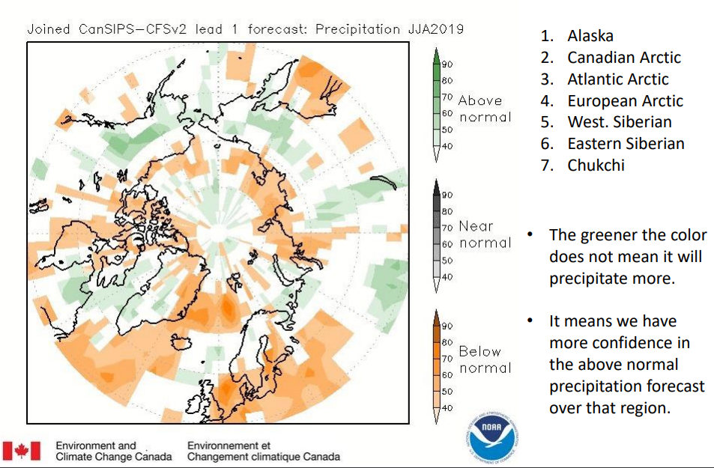
Precipitation outlook over the Arctic:
June-July-August 2019

Slide 17
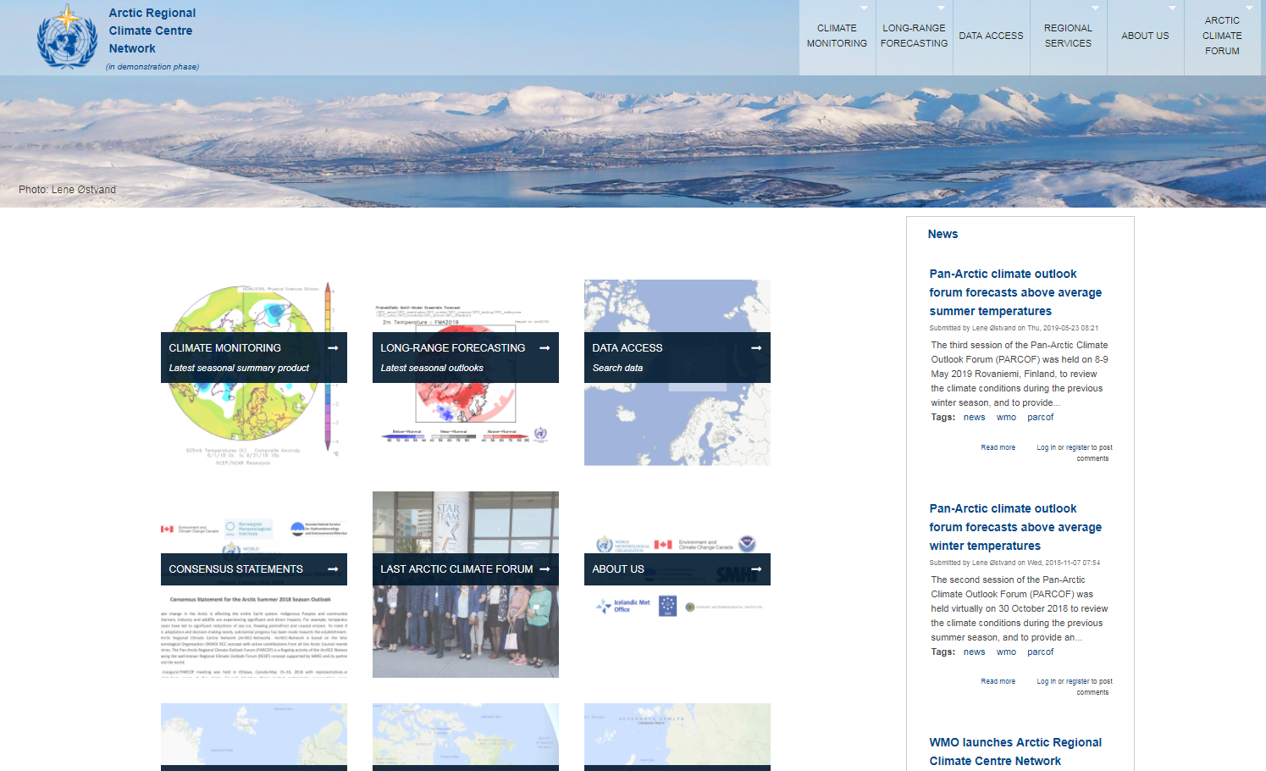
ArcRCC-N Website – https://arctic-rcc.org/

Slide 18
SAON and WMO, the way forward #1/4
WMO & Arctic Council member states operational infrastructure & activities relevant to the Arctic to be seen as part of the SAON portfolio
  Meteorological, cryosphere and hydrological observations
  Data exchange facilities
  Data processing and forecasting systems
  Climate services (ArcRCC-N, ACF)
Provide inventory of operational infrastructure elements of WMO and AC member states that are relevant to SAON for SAON inventory of national observational capacities

Slide 19
SAON and WMO, the way forward #2/4
Map SAON Strategy with WMO Strategic Plan 2020-2023, and propose & provide details on how collaboration between WMO and SAON could be strengthened and potential synergies realized
  To be submitted to the SAON Board for its review
  Will provide elements of sustainability of the meteorological priorities of AC in to the future

Slide 20
SAON and WMO, the way forward #3/4
Assist SAON on demonstrating how some of WMO relevant socio-economic benefits identified by SAON for the Arctic can be realized by using WMO and AC Members State infrastructure across whole value chain
Mechanisms & guidance for improving links at national level between SAON national representatives & Met. Services
  Priorities of Finland (Meteorology)and now Iceland in their leadership of the AC will facilitate the implementation
  Goal is to identify opportunities of collaboration at the national level and facilitate engagement of Met. Services in SAON
  Aligned with SAON Strategy and WMO Strategic Plan 2020-2023
  Aligned with Arctic Council meteorological priority which hopefully will be sustained into the future

Slide 21
SAON and WMO, the way forward #4/4
WMO is reinforcing its collaboration with the IOC of UNESCO on role of the ocean in Earth System Prediction
  Joint WMO-IOC Collaborative Board has been established by WMO Cg-18 and IOC Ass. 30
  GOOS Strategy 2030 approved by WMO Cg-18 and IOC Ass. 30
    Proposals to be made on how to enhance functional connections between co-sponsored GOOS and WIGOS
    Find common solutions towards improving Earth System prediction
  Priority on Arctic Ocean during leadership of Iceland of Arctic Council 2019-2021 can facilitate this collaboration

Slide 22

Thank you
Merci

